Slide 1

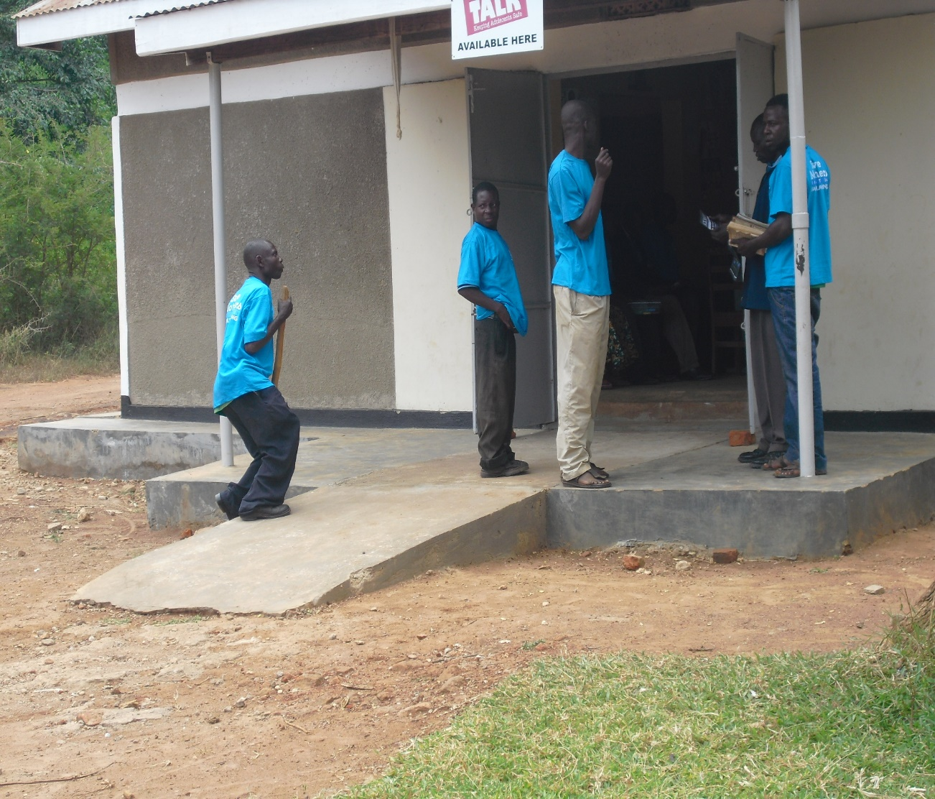
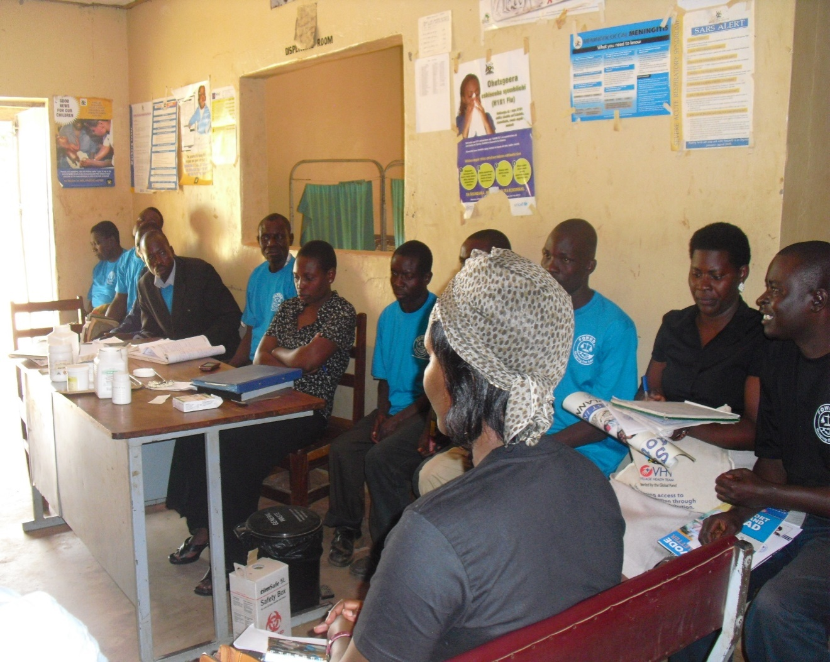
VACSI Progress Report July-September 2023
NAKURU KENYA

Slide 2
THE WORK PLAN IN BRIEF
Strategic Goal:
Increased accountability towards economic and political processes centered on and driven by women

Slide 3
THE WORK PLAN IN BRIEF
Strategic Programs
GEPP
WLP
Comm. Unit
IT
Resource Center
MAP

Slide 4
GEPP
Strategic Objective 1: Strengthened capacity of citizens to influence planning and budget processes at national and local levels for improved gender responsiveness by 2016
Output 1.1 : 280 VBC members capacities enhanced in Budget monitoring and service delivery tracking in 10 districts by 2016
Output 1.2: At least 92 Members of Parliament, District Councilors, Technocrats and CSOs capacities enhanced in gender responsive budgeting by 2016
Output 1.3 Credible GRB information and Knowledge products generated and disseminated to stakeholders by 2016
Output 1.4 Space provided for Citizens to influence planning and budgeting processes at national level and in 14 districts
Output 1.5 Increased visibility and importance of engendering national and Local government Budget amongst stakeholders by 2016

Slide 5
GEEP
Framework for the GRB Centre developed and agreed upon.
Modules for the GRB centre developed
GRB centre developed highlighting modules

Slide 6
GEPP Performance (July –September 2015)

Slide 7
VACSI
Strategic outcome :Increased effective women's participation in decision making processes at national and local level by 2016

Slide 8
Output 1 | Output 2 | Output 3
168 Civic education and empowerment exercises conducted | Enhanced participation and influence of 87 women leaders in legislative and policy processes at local and national level by 2016 | 1,000 citizens and local leaders sensitized and trained on prevention and response to GBV in 8 districts by 2016

Slide 9
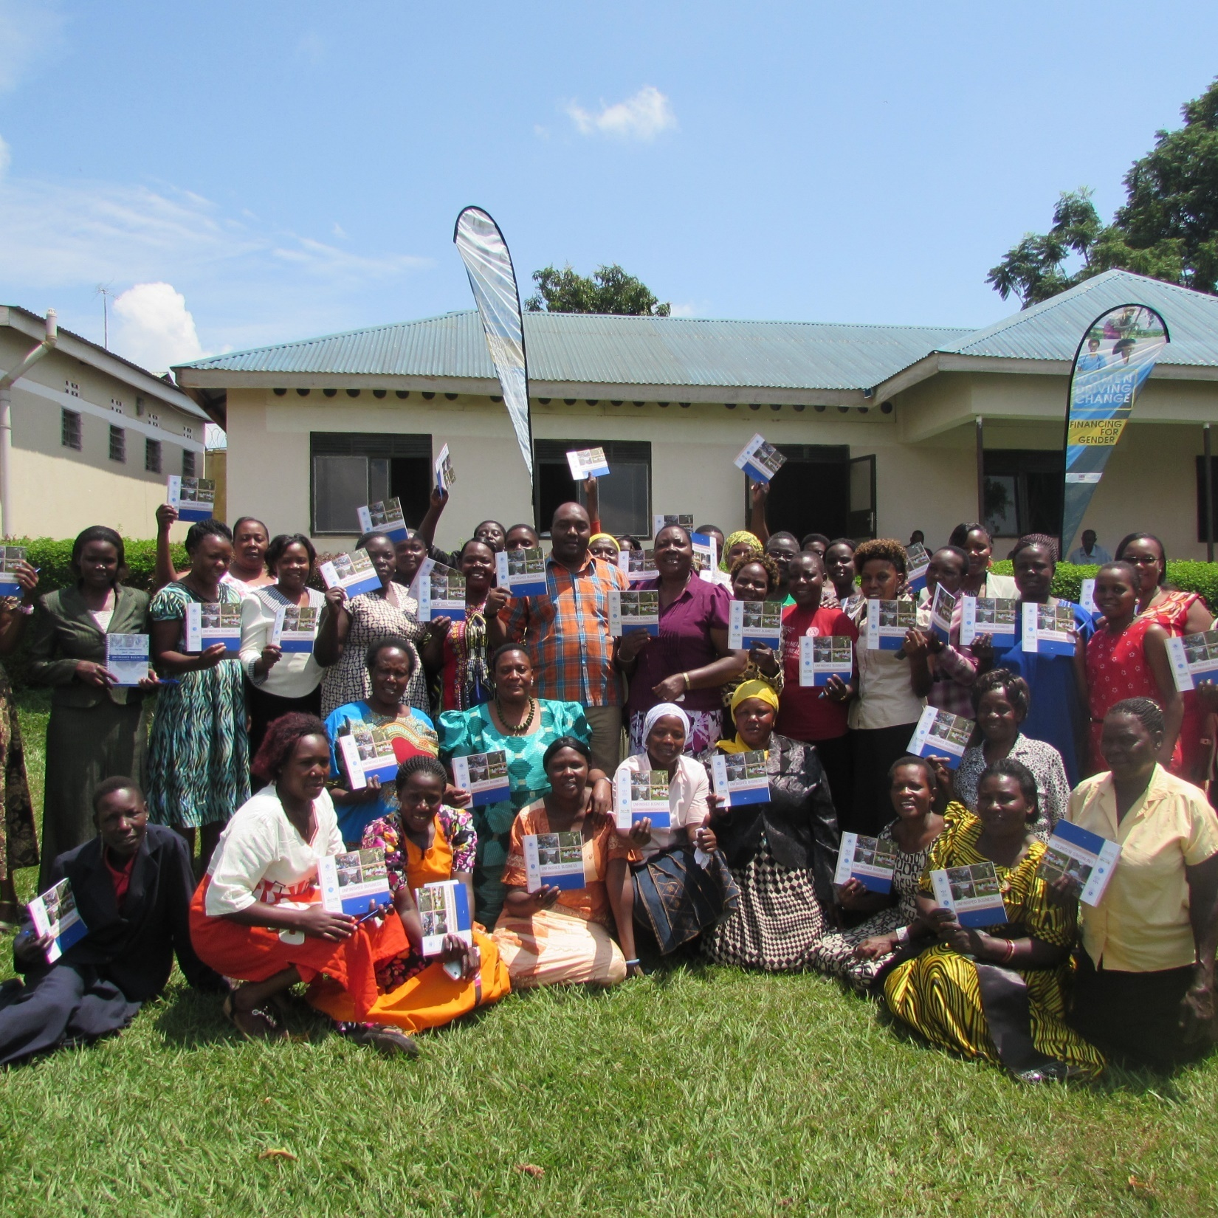
VACSI performance (July.- September 2023)

Slide 10
Comunications Unit
Output 3.1: 1612 knowledge and publicity materials produced by 2016
Output 3.2 : 6169 media events organized by 2016
Strategic Outcome 3: Increased visibility, publicity and profile of FOWODE and her programs by December 2015
Output 3.3: Increased visibility of FOWODE's work through a vibrant and informative website by 2016

Slide 11
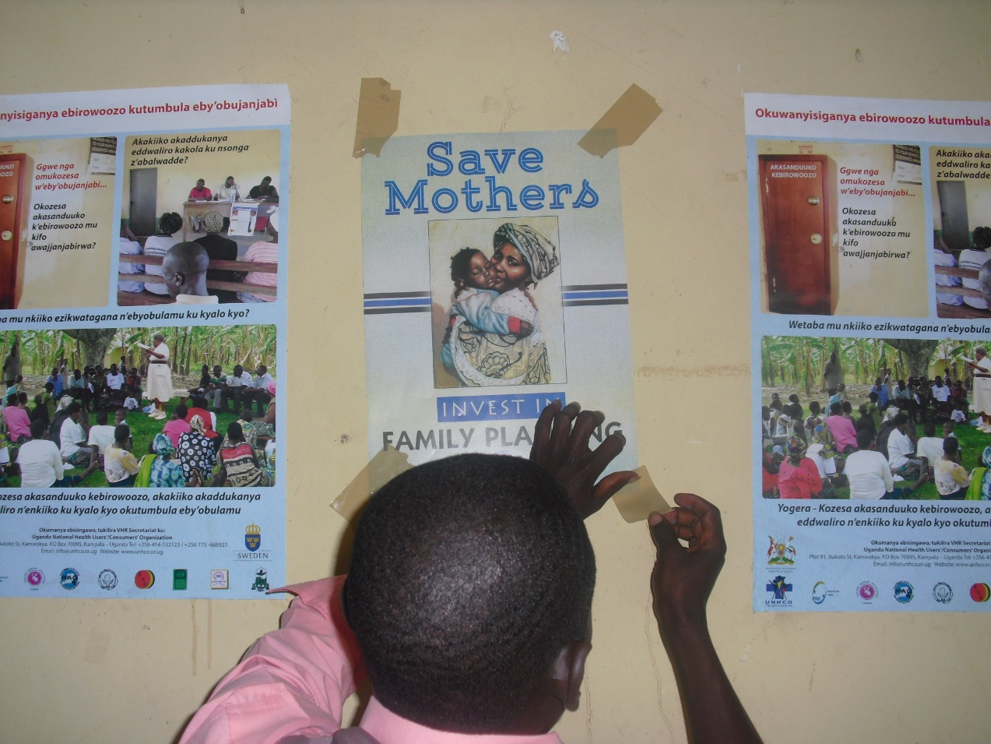
Key Results Under Communications Unit
Maintained FOWODE visibility in the public and media through
Website
Social media
E news letter
Improved the quality of our publication and other publicity materials
Provided a platform for engagement and debating gender and omen issues

Slide 12
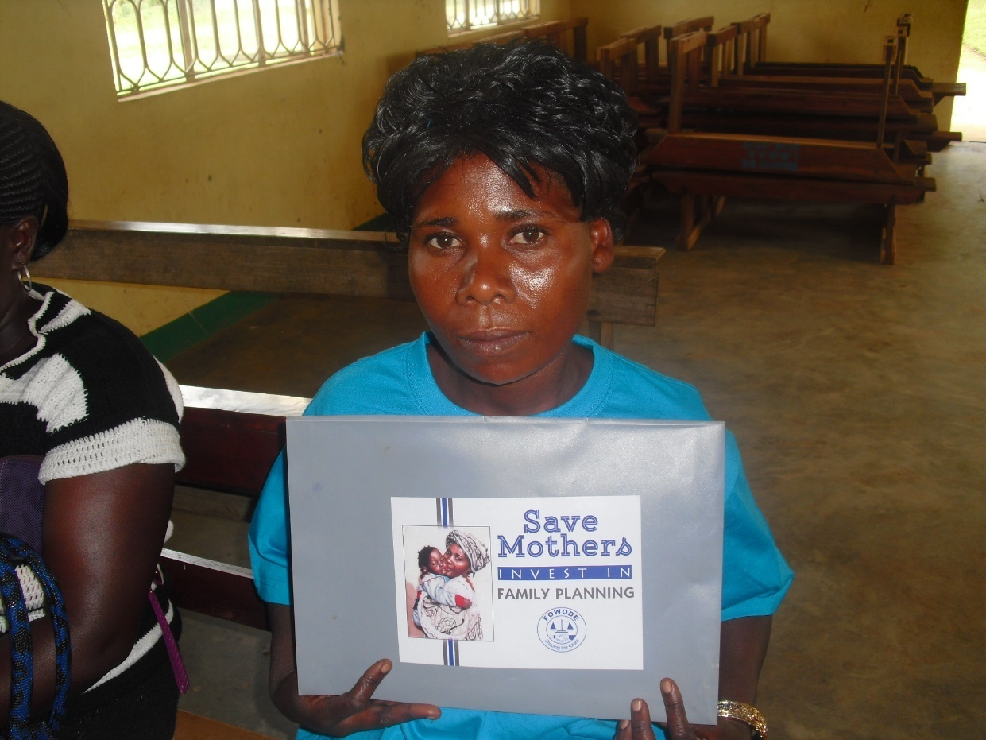
Communication Unit Performance (July September 2015)

Slide 13
Social Media Performance
 | Planned | Actual
Tweets | 52 | 52
Facebook | 52 | 52
Blog | 10 | 6
You tube | 4 | 0
 | 118 | 110

Slide 14
IT Strategic
Output 1: Maintain and improve a vibrant and informative website
Output 2: An intranet of at least 40 computers effectively communicating and fully functional Established by 2016
Resource Center
Output 1: Have accessible information resources both print and electronic format
Strategic Outcome: Enhanced Access to quality information resources among the public and FOWODE stakeholders
Outcome:Increased visibility, publicity and profile of FOWODE and her programs by December 2016

Slide 15
Key Results Under IT
Maintained all computer hard and soft ware
Provided support to staff on in IT relaled needs
Maintained and updated the website

Slide 16
Strategic Outcome: Increased usage and operationalization of Monitoring and Evaluation (M&E) system by staff for systematic information Collection, analysis and shared learning by 2016
Output 4.1: Quarterly monitoring Visits organized in 10 districts by 2016
Output 4.2: Document progress and Impact of organisational work by 2016
ME&L

Slide 17
M&EL Performance (July September 2015)

Slide 18
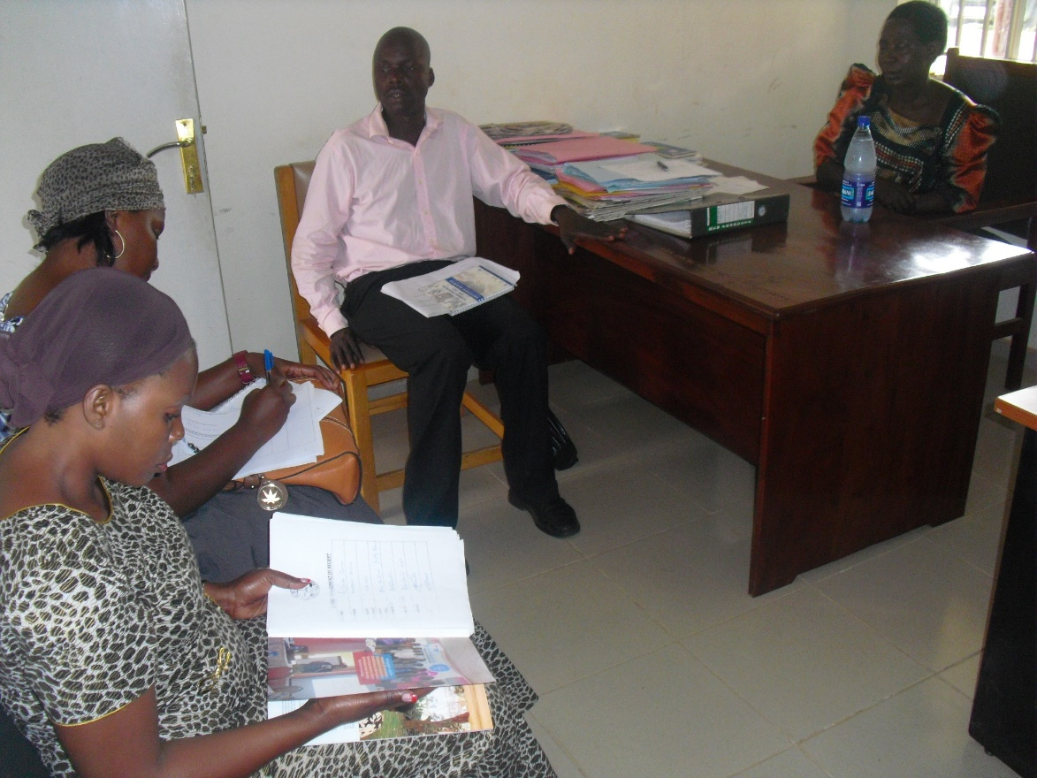
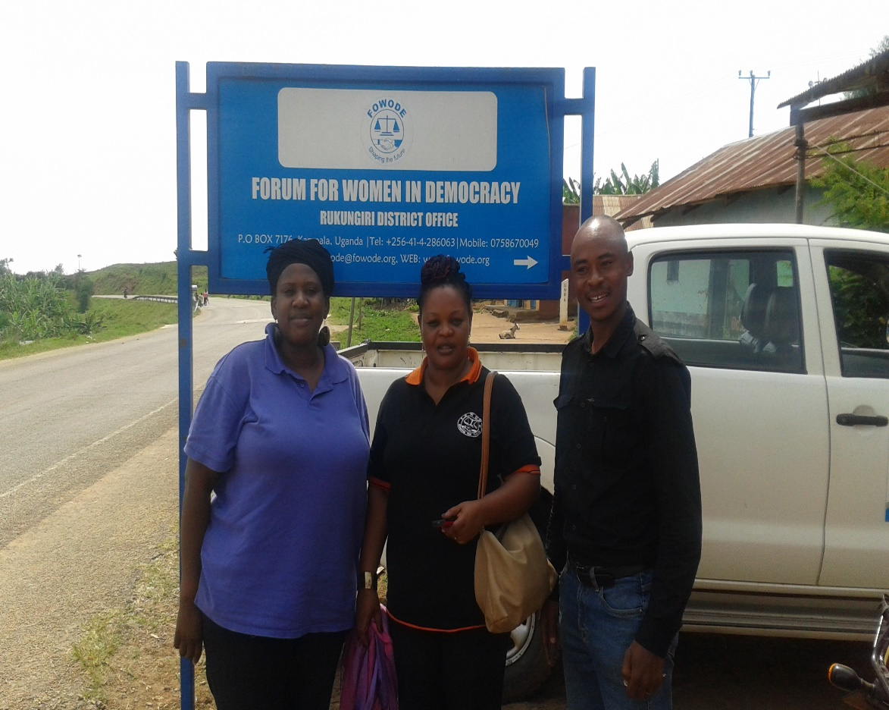
Key Results Under M&EL
Ensure that FWODE activities are documented and archived
Documentation of stories of change from Concluded projects
Measured FOWODE performance for January- June 2015
Spearheaded development of benchmark for project

Slide 19
IT Performance (July - September 2015)

Slide 20
IT UNIT
Majorly Routine work
Website management & update
Mail and domain services management
LAN administration and support
IT equipment maintenance and servicing
Organizational Data backup

Slide 21
IT UNIT
Key Results
5199 Unique visitors f0r the Website and 166253 hits
Secured user data.
No machine breakdown.
On line recovery of quick books soft ware.

Slide 22
MANAGEMENT AND ADMINISTRATION
Output 1: Two policies adopted and two policies reviewed for improved staff performance
Output 2: Twelve Governance meetings held for improved oversight function for organization programs
Output 3: Program Review meetings organized for planning and tracking progress of organizational work
Output 4: Financial and narrative reports produced for enhanced transparency and accountability
Output 5: Enhanced efficiency and effective organizational capacity to implement activities
Output 6: Five proposals developed and approved for enhanced sustainability
Output 7: 53 staff motivated and their welfare improved for effective performance
Strategic Outcome 6:
Enhanced credibility and sustainability of the organization by December 2015

Slide 23
Key Results Under MAP
Finalized policies for board approval
Respond to all Donor queries and Reporting

Slide 24
MAP Performance (July.- September )

Slide 25
Reasons for Variance
Election related activities ( party primaries delegates meeting) and nominations.
Limited resources and delay in release these funds
Mobile Money Funds transfer system trials

Slide 26


